Slide 1
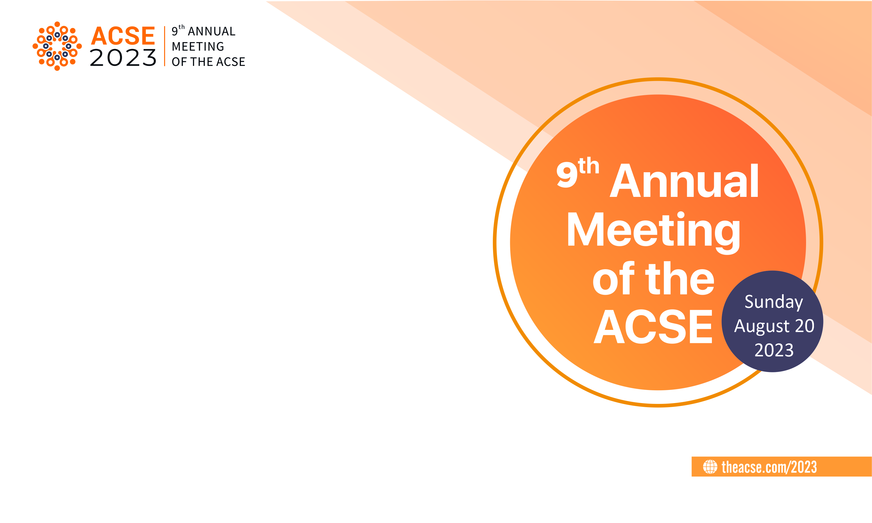
Empowering Scholarly Writers and Editors: Driving Equity and Evolution
in Scientific Publishing
Prof. Dr. Kaiser Jamil |
Bhagwan Mahavir Medical Research Centre (BMMRC), India

Slide 2

Scholarly Writers and Editors
In this presentation we broadcast that Scholarly publications are a cornerstone of the academic world, serving as a medium through which researchers communicate their findings, insights, and ideas to the global community.
Their publications play a vital role in advancing knowledge, fostering intellectual discourse, and driving the progress of various fields of Science and technology.
However, with great influence comes great responsibility, and the ethical considerations surrounding scholarly publications are of paramount importance to maintain the integrity and credibility of the academic enterprise.

Slide 3
The Significance of Scholarly Publications
Publication of scientific papers is essential for scientists for their professional advancement. However, it comes with many responsibilities.
Scholarly publications serve as the primary means through which researchers share their findings with other experts, students, and the general public.
They encompass a wide range of formats, including research articles, conference papers, reviews, monographs, and more.
These publications not only contribute to the accumulation of knowledge but also lay the foundation for further research, enable critical evaluation of ideas, and aid in the development of theories and practices.

Slide 4
The Significance of Scholarly Publications
The dissemination of knowledge through scholarly publications is a fundamental driver of scientific, technological, and societal progress.
Innovations and breakthroughs are often built upon the discoveries and insights published by earlier generations of researchers.
Moreover, these publications foster an environment of open discussion, peer review, and collaboration, enabling the refinement and validation of research methodologies, results, and conclusions.

Slide 5
The Significance of Scholarly Publications
Editors are constantly bogged down by the dilemma of how to cope with publication ethics.
Fortunately there is a committee - The Committee on Publication Ethics (COPE)”, which is a nonprofit organization whose stated mission is to define best practice in the ethics of scholarly publishing and to assist editors and publishers to achieve this goal.
Ethical standards for publication exist to ensure high-quality scientific publications, public trust in scientific findings, and that people receive credit for their work and ideas.
Many of our ASCE journals are the members of COPE. Following their guidelines have been objective of ACSE.

Slide 6
Publication Ethics
Publication ethics are a set of principles and guidelines that ensure the integrity, transparency, and fairness of the scholarly publication process.
Adhering to these ethics is crucial to maintain the trust of both the academic community and the public at large.
Some key aspects of publication ethics include:
Authorship and Attribution-

Slide 7
Publication Ethics
Proper attribution of authorship is vital.
All those who have made substantial contributions to the research should be acknowledged as authors, while those who have not should not be listed.
Honorary authorship and ghostwriting are unethical practices that undermine the credit due to genuine contributors.

Slide 8
Plagiarism and Originality:
Plagiarism, the act of presenting someone else's work or ideas as one's own, is a serious breach of ethics.
All contributions must be original, properly cited, and attributed to the original source.
Data Integrity and Reproducibility:
Researchers must accurately report their methods, data, and results to ensure that their work can be replicated and validated by others.
Fabrication, falsification, and selective reporting of data are dishonest practices that erode the foundation of scientific knowledge.

Slide 9
Editors Precautions
Editors should decline to be involved with a submission when they
Have a recent publication or current submission with any author
Share or recently shared an affiliation with any author
Collaborate or recently collaborated with any author
Have a close personal connection to any author
Have a financial interest in the subject of the work
Feel unable to be objective
Editors must declare if they have previously discussed the manuscript with the authors.

Slide 10
Peer Review Process
The peer review process is crucial in ensuring the quality and validity of scholarly publications. Editors and reviewers must maintain objectivity and confidentiality while providing constructive feedback and recommendations to authors.
Conflict of Interest:
Authors, reviewers, and editors should declare any potential conflicts of interest that could compromise the impartiality and objectivity of the research or publication process. Transparency in this regard is essential to uphold the credibility of the work.

Slide 11
Publication Transparency
Journals and publishers should be transparent about their editorial processes, review criteria, and publication fees. Selective publication of positive results, known as publication bias, distorts the overall body of knowledge and undermines the integrity of research.
Correction and Retraction:
In the event of errors, retractions, or corrections, authors and publishers must take prompt action to correct the record and communicate these updates to readers.

Slide 12
Driving Equity and Evolution in Scientific Publishing
Scholarly publications are the lifeblood of academia, fostering the exchange of knowledge, ideas, and insights that drive progress across disciplines.
Upholding ethical standards in the publication process is vital to ensure the reliability, credibility, and trustworthiness of the academic community's contributions to society.
Researchers, publishers, reviewers, and institutions must collectively commit to practicing rigorous publication ethics to uphold the integrity of scholarly publications and the broader pursuit of knowledge.
Through such ethical practices, scholarly publications will continue to serve as a beacon of truth and discovery in our ever-evolving world.

Slide 13
Thank you

